Slide 1


Data-Driven Framework for Enhancing Student Applications, Acceptances, and Registrations at the University of Buckingham
MSc Applied Data Science Final Project Presentation
By: Mr. Chidera Kenechukwu Onwumbiko
Supervised by: Prof. Harin Sellahewa

Slide 2
Agenda
Introduction
Methodology Overview
Predictive Model
Exploratory Data Analysis (EDA)
Discussion, Conclusion, Future Work
What I learnt from this research.

Slide 3
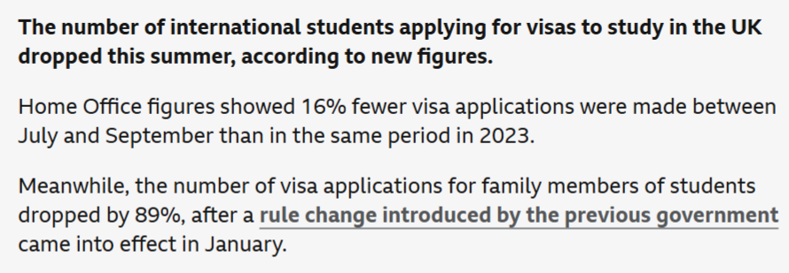

Introduction
Why was this research conducted?
BBC News (2024)
What are these figures saying?
Objective: This brings us to the main objective of this research which is to develop a data-driven framework to help the University of Buckingham better understand its student enrolment processes which will help mitigate these issues.

Slide 4
Methodology Overview
What processes were undertaken in this research?
Data Collection
Data Preprocessing
Data Visualisation
Predictive Model Development
Model Evaluation
Data Cleaning
Handling Missing Values
Data Validation
Unpivoting
Merging
Feature Engineering

Slide 5
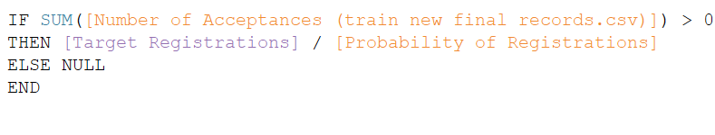
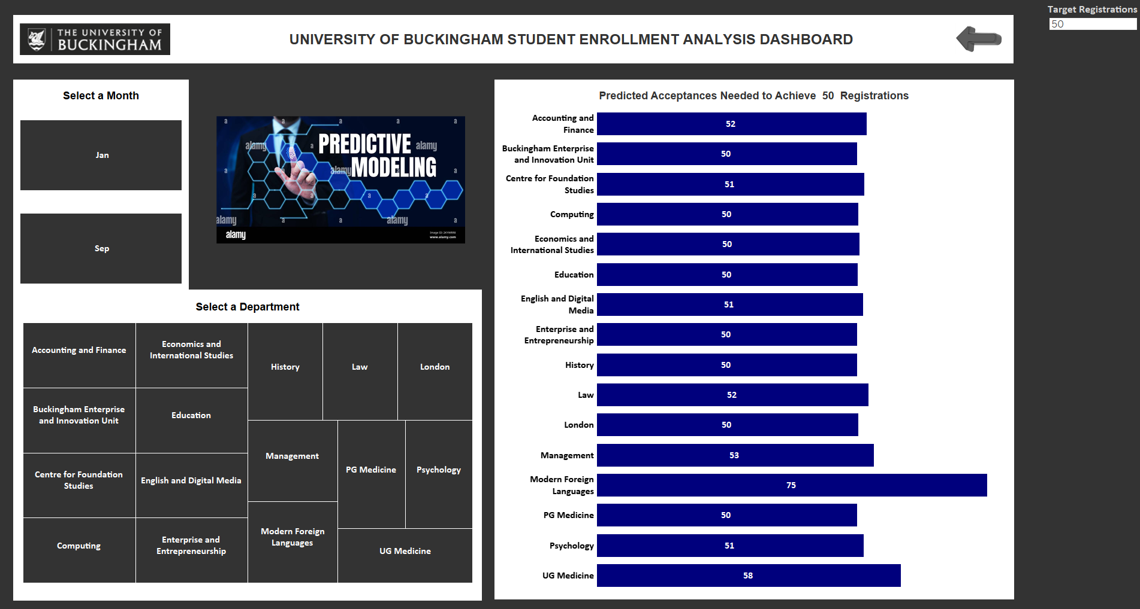
Predictive Model
Implemented Statistical Formula on Tableau
Predictive Model Dashboard

Slide 6
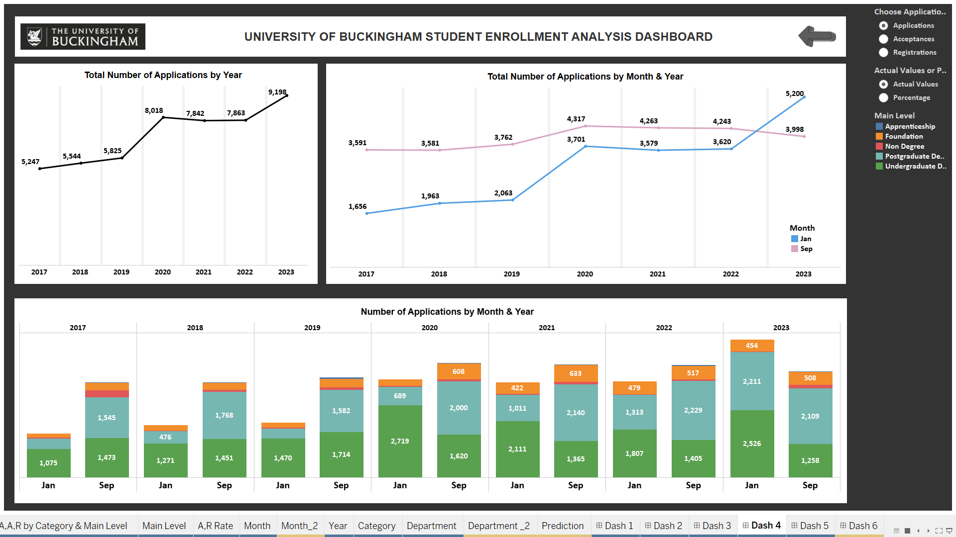
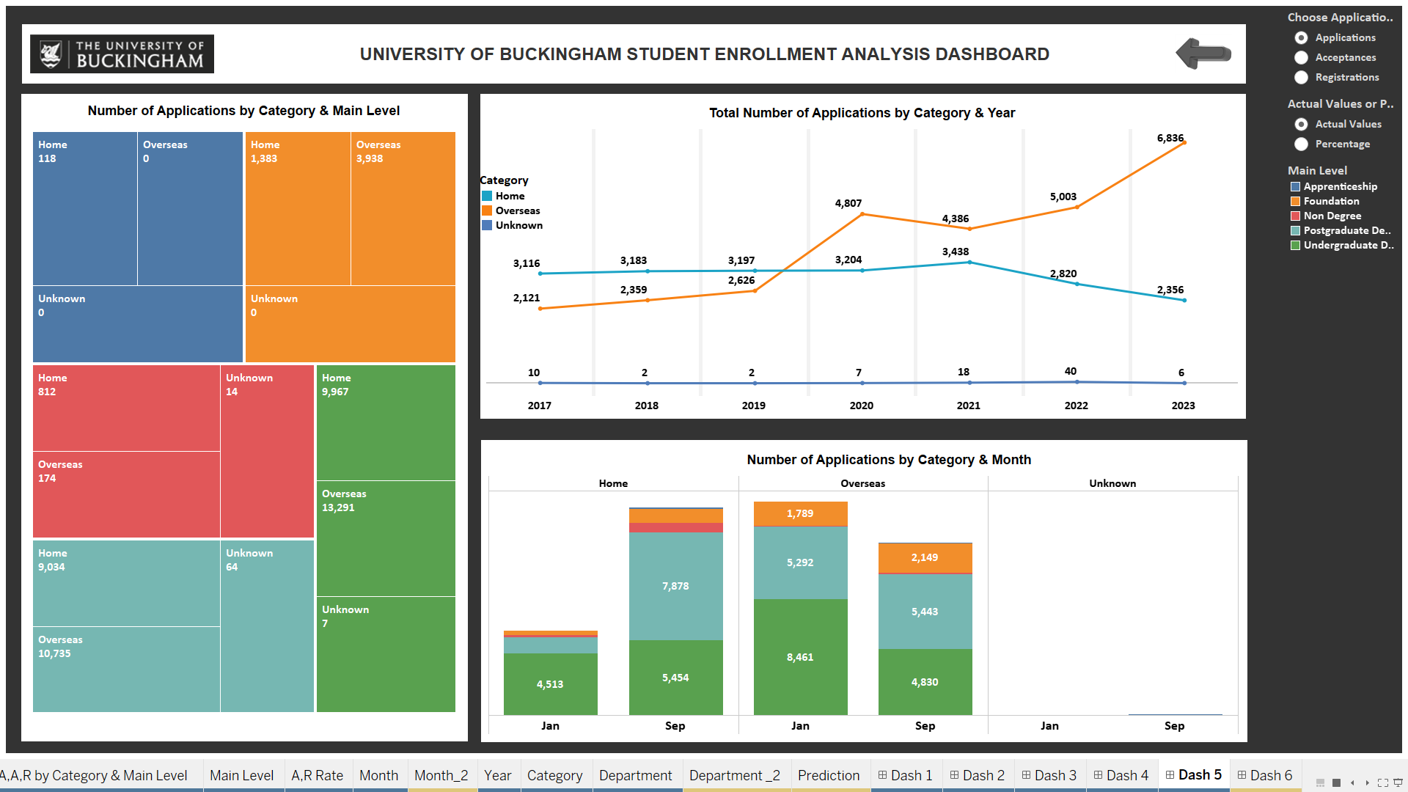
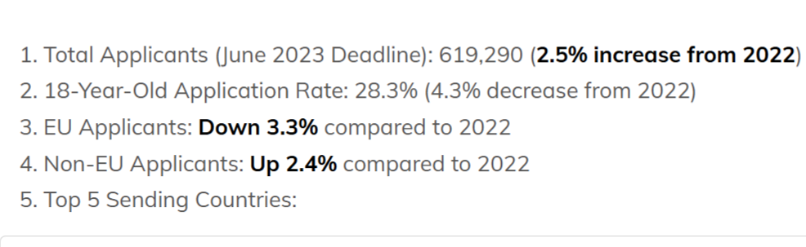
Exploratory Data Analysis
What was discovered from this research?
UCAS (2024)
More analysis will be shown during demonstration.

Slide 7
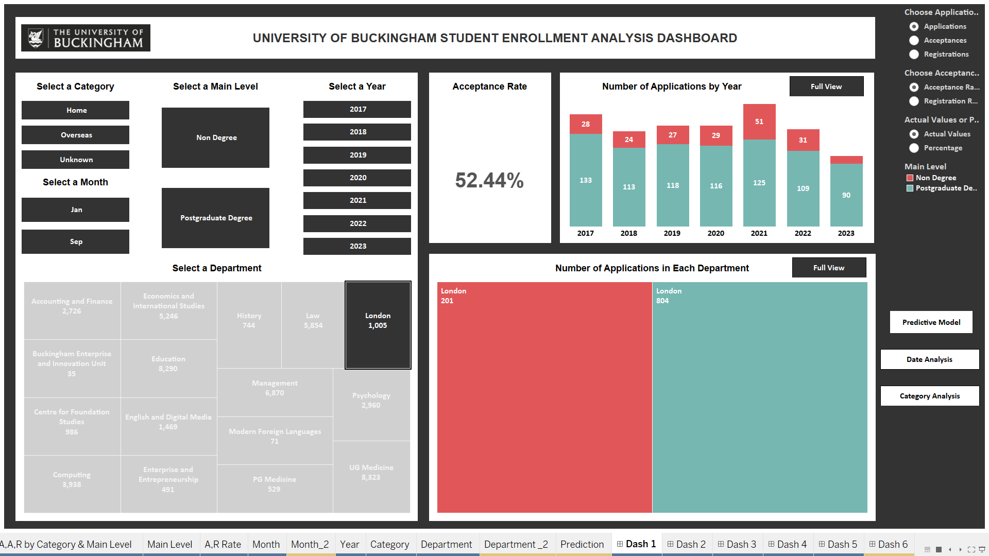
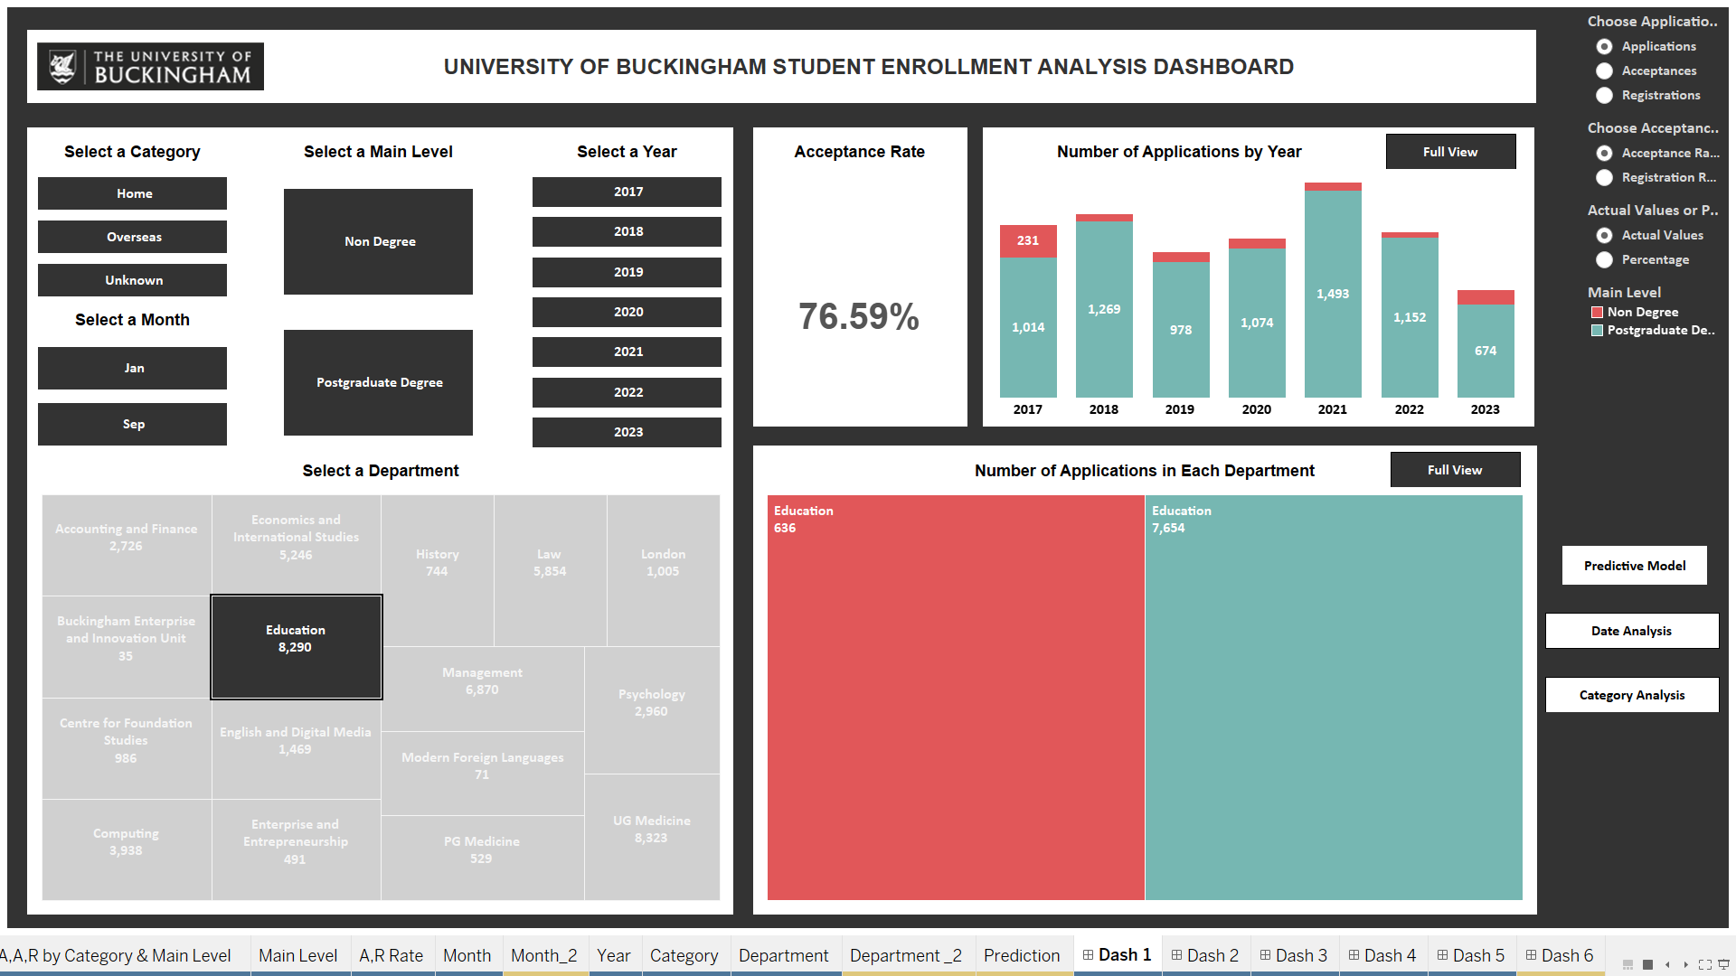
Exploratory Data Analysis
More analysis will be shown during demonstration.

Slide 8
Discussion, Conclusion, and Future Work
Challenges and Considerations:
Data quality and consistency.
Data privacy and ethical considerations.
Organisational structure and adoption.
Benefits:
Enhanced decision making.
Targeted recruitment campaigns.
Interactive scenario analysis.
Improving enrolment rate analysis.
Future work:
Expanding the dataset.
Address data privacy and ethical concerns.
Incorporate machine learning.
Incorporate up to date data.

Slide 9
WHAT DID I LEARN FROM THIS RESEARCH WHICH WAS NOT TAUGHT IN THE CLASSROOM?
Tableau
Statistical Predictive Modelling
Business Understanding Skills

Slide 10

Demonstration

Slide 11

Questions?

Slide 12

I HOPE YOU ENJOYED IT. THANK YOU!

